Slide 1


Fake news detection
Ahmed gamal , raheem ismail , ahmed gonga , alaa fadel, yousif kamal

Slide 2

Naive Bayes classifier
01

Slide 3

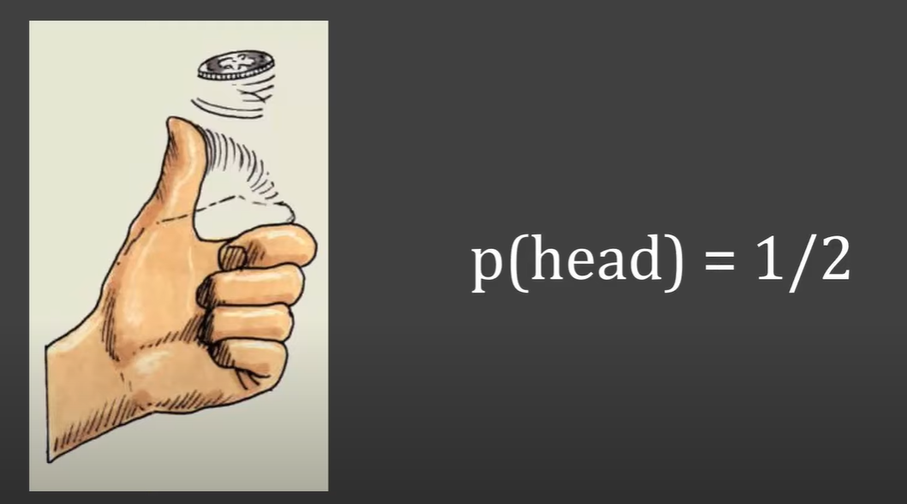
basics of probability

Slide 4

lets asume you pick a random card, you know it is a diamond. now what is the probbility of the quuen

Slide 5
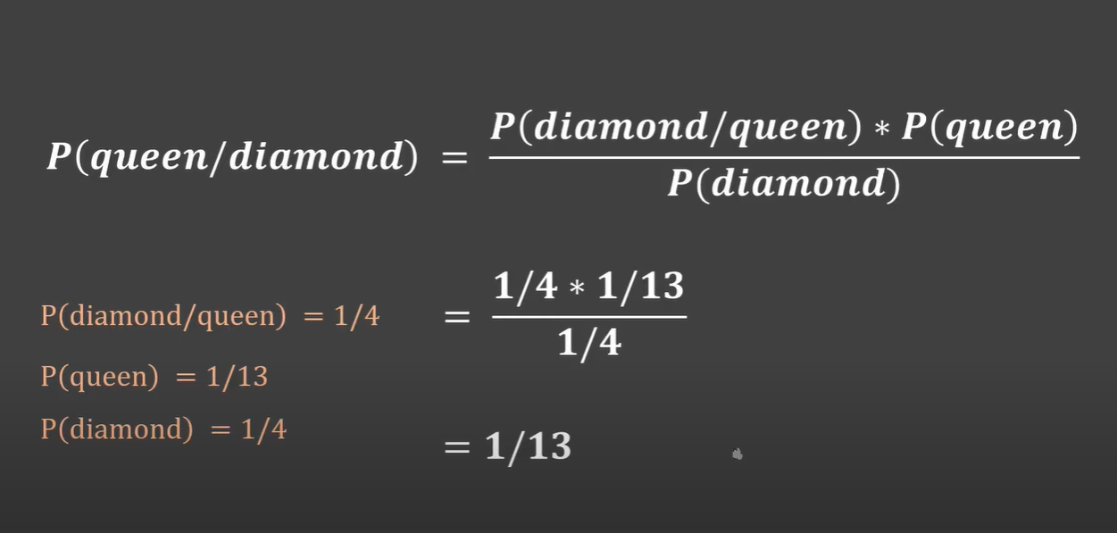
conditional probability

Slide 6
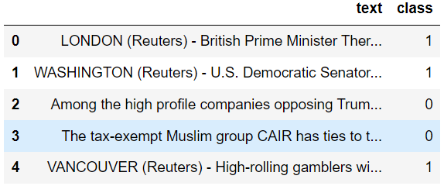
Data-set

Slide 7

THANK YOU

